Slide 1
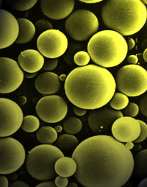
MICROSPERES AND MICROCAPSULES

Slide 2
Contents^{[1-9]}
Definition
History
Microsphere and microcapsule markets
Microspheres
Manufacturing techniques
Manufacturing variables
Analysis of microspheres
Advantages & applications of microspheres
Microcapsules
Characteristics of microcapsules
Manufacturing techniques of microcapsules
Applications of microcapsules
Mechanism of drug release
References

Slide 3
Definition
Micro-particles are defined as the polymeric entities falling in the range of 1-1000 μm, covering two types of the forms as follows:
Microcapsules: micrometric reservoir systems
Microspheres: micrometric matrix systems.

Slide 4
.
= Polymer Matrix
} = Entrapped Drug
Drug Core
Polymer Coat
MICROCAPSULES MICROSPHERES
According to some authors, microspheres are essentially spherical
in shape, whereas, microcapsules may be spherical or non-spherical
in shape.
Also, some authors classify microparticles, either microcapsules
or microspheres, as the same: ‘microcapsules’.

Slide 5
HISTORY
The concept of packaging microscopic quantities materials within microspheres dates to the 1930s: “the work of Bungenberg de Jong and co-workers on the entrapment of substances within coacervates”.
In the early 1950s Barrett K. Green developed the microencapsulation that used the process of phase-separation-coacervation.
The first successful commercial development of a product containing microcapsules was “carbonless copy paper” developed by the National Cash Register Company that eliminated the requirement of carbon paper.
The first pharmaceutical product consisting of microcapsules was a controlled-release aspirin product.
In recent years, the microencapsulation processes are used in many industries such as food, food additives, cosmetics, adhesives, household products and agricultural materials as well as the aerospace industry and many more.

Slide 6
Microsphere and Microcapsule Markets
Chemical: carbonless copy paper, catalysts, paints, adhesives, corrosion inhibitors
Agricultural:pesticides/herbicides/fungicides, growth regulators, food, supplements for animal feed, veterinary medicines
Consumer: detergents, antiperspirants, over the counter medicines
Pharmaceutical: antibiotics, bio-cells, medicines, bioactive agents
Food: flavors, preservatives, vitamins/nutrients, colorants

Slide 7
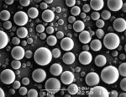
MICROSPHERES
MANUFACTURING TECHNIQUES
I. Polymer phase separation
→ Polymer phase separation in non-aqueous media, by non-solvents or polymer addition, also referred to as ‘Coacervation.’
Method:
Ø The coacervation of a polymer such as poly-(d,l-lactic acid-coglycolic acid) (PLAGA) dissolved in methylene chloride with a second polymer such as silicone oil that allows the formation of matrix systems.
Ø If crystals of active principles are placed in suspension at the beginning of this process, they will be captured in these matrices after the desolvation of PHCA (poly-alpha-hydroxy-carboxylic acids)

Slide 8
II. SOLVENT EVAPORATION AND SOLVENT EXTRACTION
Method:
Ø The polymeric supporting material is dissolved in a volatile organic solvent.
Ø The active medicinal principle to be encapsulated is then dispersed or dissolved in the organic solution to form a suspension, an emulsion or a solution.
Ø Then, the organic phase is emulsified under agitation in a dispersing phase consisting of a non-solvent of the polymer, which is immiscible with the organic solvent, which contains an appropriate surface-active additive.
Ø Once the emulsion is stabilized, agitation is maintained and the solvent evaporates after diffusing through the continuous phase.
Ø The result is the creation of solid microspheres.
Ø On the completion of the solvent evaporation process, the microspheres held in suspension in the continuous phase are recovered by filtration or centrifugal and are washed and dried.

Slide 9

EMULSION SOLVENT EVAPORATION TECHNIQUE

Slide 10
III. WAX COATING AND HOT-MELT TECHNIQUE
→ In this method, Wax is used to coat the core particles.
Method:
Ø Most commonly a simple emulsion is formed, where the drug or other substance to be encapsulated is dissolved or dispersed in the molten wax.
Ø This waxy solution or suspension is dispersed by high speed mixing into a cold solution, like cold liquid paraffin. The mixture is agitated for at least one hour.
Ø The external phase (liquid paraffin) is then decanted and the microspheres are washed with hexane and allowed to air-dry.
→ These wax-coated microspheres can be successfully tabletted.

Slide 11
IV. SPRAY COATING AND PAN COATING
Ø Spray coating and pan coating use a heat-jacketed coating pan in which the solid drug core particles are rotated and into which the coating material is sprayed.
Ø The core particles are in the size range from a micrometers upto a few millimeters.
Ø The coating material is usually sprayed at an angle from the side into the pan.
Ø The process is continued until an even coating is completed.

Slide 12
V. COACERVATION
→ In the presence of only one macromolecule, this process is referred to as ‘Simple Coacervation.’
→ When two or more macromolecules of opposite charge are present, it is referred to as ‘Complex Coacervation.’
Ø This process includes separation of a macromolecular solution into two immiscible liquid phases, a dense coacervate phase, which is relatively concentrated in macromolecules and a dilute equilibrium phase.
Ø It is then cross-linked to form stable microspheres by the addition of an agent such as gluteraldehyde or by the application of heat.

Slide 13
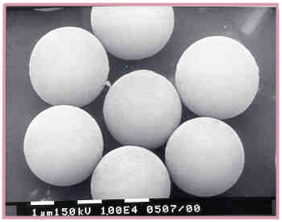
VI. PRECIPITATION
Ø An emulsion is formed, which consists of polar droplets dispersed in a non-polar medium. Solvent may be removed from the droplets by the used of a co-solvent.
Ø The resulting increase in the polymer-drug concentration causes a precipitation forming a suspension of microspheres.

Slide 14
VII. FREEZE-DRYING
→ This method involves the freezing of emulsion.
Ø The continuous-phase solvent is usually organic and is removed by sublimation at low temperature and pressure.
Ø Finally, the dispersed-phase solvent of the droplets is removed by sublimation, leaving microspheres containing polymer-drug particles.

Slide 15
VIII. Chemical and thermal cross-linking
→ Microspheres made from natural polymers are prepared by
a cross-linking process. The polymers include: Gelatin, Albumin, Starch and Dextrin.
Ø A water-in-oil emulsion is prepared, where the water phase is a solution of the polymer that contains the drug to be incorporated. The oil phase is a suitable vegetable oil or oil-organic solvent mixture containing an oil-soluble emulsifier.
Ø Once the desired w/o emulsion is formed, the water-soluble polymer is solidified by some kind of cross-linking process. This may involve thermal treatment or the addition of a chemical cross-linking agent such as glutaraldehyde to form a stable chemical cross-links.

Slide 16
Manufacturing Variables in the production of microspheres
The most important physicochemical characteristics that may be controlled in microsphere-manufacture are:
1. Particle Size
Particle Size and Distribution
Molecular Weight of Polymer
Ratio of Drug to Polymer
Total Mass of Drug and Polymer

Slide 17
Analysis Of Microspheres
Electron Microscopy, Scanning Electron Microscopy and Scanning Tunneling Microscopy – Surface Characterization of Microspheres
Fourier Transform Raman Spectroscopy or X-ray Photoelectron Spectroscopy –to Determine If Any Contaminants Are Present
Surface Charge Analysis Using Micro-electropshoresis –Interaction of Microspheres Within the Body

Slide 18
STERILIZATION OF MICROSPHERES
Microspheres that are administered parenterally must be sterile.
Sterilization is usually achieved by aseptic processing.
Sterility assurance is also a problem for microsphere system
A method has been developed whereby the presence of viable organisms in the interior of microspheres systems can be determined without breaking the microcapsules/microspheres; it involves the detection of the organism metabolism.

Slide 19
ADVANTAGES as well as
APPLICATIONS of Microspheres
Taste masking
Enteric coating Sustained and controlled release
Instability to environment (O₂, H₂O) and volatility
Separation of incompatibles
Administration in solid state and dry handling
Improvement of flow
Detoxification

Slide 20
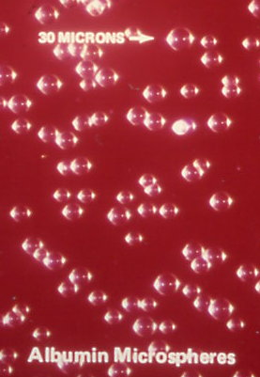
These days,
The technology of microsphere-production is so advanced that
Albumin microspheres are also produced

Slide 21
Targeting
To a particular group of cells within the body such as Kupffer cells and even to intracellular structures like lysosomes or the cell nucleus.
Now-a-days, Radio-Active as well as Florescent Microspheres are used for targeting.

Slide 22
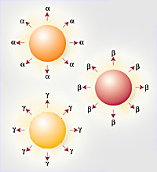
Florescent and
Radio-active
Microspheres
Radio-active microspheres are glass microspheres which emit alpha, beta or gamma radiation either individually or in combination.
Fluorescent microspheres are a sensitive non-radioactive method of measuring regional blood flow by dye extraction. After recovery of the microspheres from the harvested tissue samples, the dye is extracted and quantified by fluorescence spectrophotometry.

Slide 23
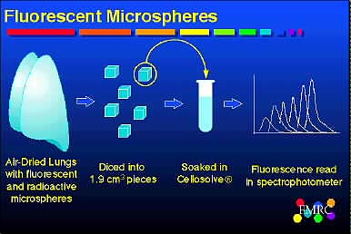
Analysis of Florescent Microspheres

Slide 24
Advantages of Florescent Microspheres over Radio-active Microspheres
Greatest advantage of fluorescent microspheres is that they can be used in studies where radioactivity is not permitted.
Other advantages are:
physiology studies
labs that are not cleared for radioactivity
countries that do not allow radioactivity

Slide 25
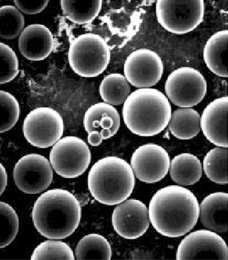
MICROCAPSULES
CHARACTERISTICS OF MICROCAPSULES
Ø The core material used plays an important role in the production of microcapsules. It decides the process as well as the polymer that should be used as the coating material. The core-material should be insoluble and non-reactive with the coating material and the solvent used.
Ø The unique feature of microcapsules is the small sized coated particles and their use and adaptation to a wide variety of dosage forms.

Slide 26
Ø Due to the smallness of the particles, drugs can be widely distributed throughout the GI tract, hence improving the drug absorption.
Ø Microcapsules can be single-particle or aggregate structures. They vary in size from 1 to 500 nm. Most of the microcapsules are below 100 nm in size.
Ø The quantity of polymer coating can vary from 1 to 70% of the weight of the microcapsule. In most of the cases, it is between 3 and 30% corresponding to a dry polymer coating film thickness of less than 0.1 to 50 nm.

Slide 27
Ø Biodegradable polymers are also used in microcapsule production.
Ø The coating can be made rigid, fragile or strong. Strength is controlled by the choice of the polymer, coating thickness and plasticizer.
Ø They are highly stable.

Slide 28
MANUFACTURING TECHNIQUES OF MICROCAPSULES
Type A (Chemical processes)
Coacervation phase separation
Polymer-polymer incompatibility
Interfacial polymerization in liquid media
Polymerization at liquid-gas or solid-gas interface
In situ polymerization
In-liquid drying
Thermal and ionic gelation in liquid media
Desolvation in liquid media
Emulsion solvent evaporation technique

Slide 29
TYPE B: MECHANICAL PROCESSES
Pan coating
Spray drying and congealing
Spray chilling
Fluidized bed / air suspension technique
Electrostatic deposition
Solvent evaporation
Centrifugal extrusion / multi-orifice centrifugal
Spinning disk or rotational suspension separation
Pressure extrusion or spraying into solvent extraction bath.

Slide 30
A.COACERVATION-PHASE SEPARATION
→ This process may be used to microencapsulate a variety of liquids, solids, solutions and dispersions of solids in liquids.
→ The polymers used to coat the materials should be soluble in water or any other solvent used.
→Water-soluble core materials are microencapsulated in organic solvents, whereas, water-insoluble materials are microencapsulated in water.

Slide 31
Types of Coacervation-Phase Separation
I. Simple Coacervation
Ø It includes a simple coacervation process in which microencapsulation is carried out by using water as the solvent phase and a water-soluble polymer as the coating material. Coacervation is induced by the addition of a soluble salt.
Ø Example: An oily material Vitamin A Palmitate is micro-encapsulated in gelatin by adding a water-soluble salt.

Slide 32
II. Complex Coacervation
→ This method is based on the ability of cationic and anionic water-soluble polymers to interact in water to form a liquid, polymer-rich phase called a complex coacervate. Gelatin is normally the cationic polymer used. A variety of natural and synthetic anionic water-soluble polymers interact with gelatin to form complex coacervates suitable for encapsulation.
→ This technology usually produces single capsules of 20-800 μm diameter that contain 80-90% by weight core material.

Slide 33
Ø If a water-insoluble core material is dispersed in the system and the complex coacervate wets this core material, each droplet or particle of dispersed core material is spontaneously coated with a thin film of coacervate.
Ø When this liquid film is solidified, microcapsules are formed.

Slide 34
NON-SOLVENT ADDITION TECHNIQUE
→ These processes are designed to produce microcapsules of solids that are insoluble in the solvent – non-solvent pairs.
Method:
Ø In this process, phase separation is induced by the addition of a non-solvent to a solution of a polymer.
Ø The ability of the non-solvent to cause the polymer to separate is measured by the solubility parameter. As the solubility parameter of the non-solvent and the polymer surpasses 1.1, liquid phase separation occurs.
Ø When a core material wettable by the polymer is present, microcapsules are formed.

Slide 35
TEMPERATURE CHANGE
TECHNIQUE
Method:
Ø This process involves a polymer soluble in a solvent at elevated temperature but insoluble in the same solvent at room temperature.
Ø When certain polymers are dispersed in a cold solvent with a core material present, heating the mixture with agitation to a selected temperature and slowly cooling the dispersion back to room temperature can result in microencapsulation.
Ø For example: Water-insoluble liquids can be microencapsulated in methylcellulose from water, and water-soluble solids can be microencapsulated in ethylcellulose from cylcohexane.

Slide 37
POLYMER-POLYMER INCOMPATIBILITY TECHNIQUE
→ This is probably the most classical method to produce microcapsules. This technology utilizes a polymer phase-separation phenomenon.
Method:
Ø The polymer-polymer incompatibility occurs because two chemically different polymers dissolved in a common solvent are incompatible and do not mix in solution.
Ø They repel each other and form two distinct liquid phases. One phase is rich in polymer designed to act as the capsule shell. The other one is rich in the incompatible polymer. The incompatible polymer is present in the system to cause formation of two phases.

Slide 38
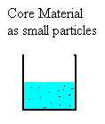
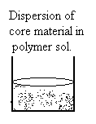
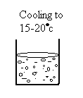
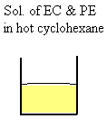
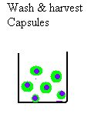
POLYMER POLYMER
INCOMPATIBILITY TECHNIQUE

Slide 39
INTERFACIAL POLYMERIZATION
→ The capsule shell is formed at or on the surface of a droplet or particle by polymerization of reactive monomers.

Slide 40
A monomer is dissolved in the liquid.
Ø The resulting solution is dispersed to a desired particle size in an aqueous phase that contains a dispersing agent.
Ø A co-reactant, usually a multifunctional amine, is then added to the aqueous phase. This produces a rapid polymerization reaction at the interface, which generates the capsule shell.

Slide 41
IN-SITU POLYMERIZATION
Ø Microcapsule shell formation occurs as a result of polymerization of monomers added to the encapsulation reactor.
Ø Polymerization occurs both in the continuous phase and on the interface formed by the dispersed core material and continuous phase.
This technique produces small: 3 to 6 μm diameter microcapsules. Larger microcapsules are used for cosmetic applications.

Slide 42
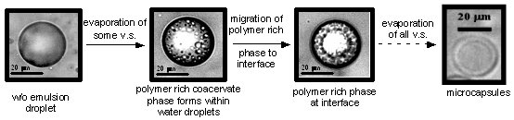
Emulsion Solvent Evaporation Technique

Slide 43
TYPE B: MECHANICAL PROCESSES
1. Spray drying
2. Fluidized bed technique

Slide 44
3. CENTRIFUGAL EXTRUSION
Ø The core and shell material, which are two mutually immiscible liquids, are pumped through a spinning two-fluid nozzle.
Ø This produces a continuous two-fluid column or rod of liquid that spontaneously breaks up into a stream of spherical droplets immediately after it emerging from the nozzle. Each droplet contains a continuous core region surrounded by a liquid shell.

Slide 45
→ How these droplets are converted into capsules is determined by the nature of the shell material. If the shell material is a relatively low-viscosity hot melt that crystallizes rapidly on cooling, the droplets are converted into solid particles as they fall away from the nozzle.
→ Suitable core materials typically are polar liquids like water or aqueous solutions, since they are immiscible with a range of hot melt shell materials like waxes.

Slide 46
4. ROTATIONAL SUSPENSION SEPARATION
Ø In this process, core material dispersed in a liquid shell formation phase is fed onto a rotating disk.
Ø Individual core particles coated with a film of shell formulation are flung off the edge of the rotating disk along with droplets of pure coating material.
Ø When the shell formulation is solidified eg: by cooling, discrete microcapsules are produced.
Ø The droplets of pure coating material also solidify, but they are said to collect in a discrete zone away from the microcapsules. In order to obtain optimal results, the core material must have a spherical geometry.

Slide 48
APPLICATIONS OF MICROCAPSULES
It is possible to microencapsulate nearly all the classes of drugs, by selecting a suitable type of coating material. Following are some of the commonly used coating materials:
Gelatin, Carrageenan, Gum Arabic, Cellulose Acetate Phthalate, Carboxy Methyl Cellulose,
Ethylcellulose, Methylcellulose, Shellac and Waxes
2. Micro-capsules can be formulated into a variety of useful dosage forms, which include powders, hard gelatin capsules, rapidly disintegrating tablets and chewable tablets, oral liquid suspension, ointments, creams, lotions, plasters, dressings and suppositories.
Example: A rapidly disintegrating aspirin tablet contains aspirin microcapsules formed from avicel, cornstarch and guar gum.

Slide 49
Microcapsules can also be used for prolonged-action or sustained-release formulation. Here, the coatings are applied to small particles of drug and this contributes to the more uniform distribution of drug throughout the GI Tract.
Microcapsules also improve the stability of a formulation.
Separation or isolation of reactive materials in the same dosage form can be accomplished by microencapsulation.
Liquid oral suspensions are readily produced with microcapsules. Both permanent and re-constitutable suspensions are achievable with microcapsules to provide taste masking or sustained-release products.

Slide 50
7. Microcapsules can be used to convert liquids to solids.
Example: Liquid such as Flavors, Fish Oils, Vegetable Oils, Silicone Oils and Vitamins. Microcapsules of such materials can be utilized in suspension or dry powder form.
8. Taste-masking: It is not only that the taste is masked but also the microcapsule size is so small that it prevents mouth feel and aftertaste.
Example: The most common drugs that are taste-masked are: Aspirin, Acetaminophen, Ampicillin, Caffeine, Dicloxacillin, Diethylcarbamazine Citrate, Naproxen, Phenylbutazone and others.

Slide 51
9.Gastric–irritation can also be reduced by microencapsulation, in which, the drug particles are coated with a thin GI-fluid–resistant film. This film separates the irritant particle from the mucosal lining, minimizing the irritant effects.
Example: Potassium Chloride is GI-irritant material. So it when it is microencapsulated and dosed in a hard gelatin capsule, the formulation reduces the gastric irritation.

Slide 52
Release Mechanisms
Mechanical rupture (via pressure) -Commercial products like Carbonless Copy Paper
Thermal release - products for catalysts
Wall dissolution - via solubility or chemical reaction
Photochemical
Biodegradation

Slide 53
The drug release rate is a function of the following:
The film’s permeability to water
The solubility of the salt in water
The film thickness
The surface area of the microcapsule
The permeability of the polymer to the saturated solution
The concentration gradient across the membrane
Temperature and other factors.

Slide 54
The following figure demonstrates a water-soluble salt microencapsulated in ethyl cellulose, which is dispersed in water.
R1
Where,
R1 = rate of solvent permeation
R2 = rate of drug dissolution
R3 = rate of dissolved drug
permeation
R2
R3

Slide 55
Ø The release mechanism is independent of the pH, provided the solubility of the polymer is independent of pH and the solubility of the core material in water is also independent of pH.
Ø The resultant release rate ‘Rr’ can be described as a first-order rate process, which obeys the following equation.
dc/dt = kc
where,
k = rate constant
c = amount of core material remaining in the microcapsule.
For controlled-release formulations, zero-order release is preferred.

Slide 56
REFERENCES
Encyclopedia of pharmaceutical technology, Edited by James Swarbrick, James C. Boylan, printed by Marcel Dekker Inc., 1994, volume 9
Encyclopedia of pharmaceutical technology, Edited by James Swarbrick, James C. Boylan, printed by Marcel Dekker Inc., 1994, volume 10
www.artecoll.com/ microspheres.jpg
www.kubiatowicz.com/.../ Albumin_Microspheres.jpg
www.indiamart.com/tureen/
www.tlchm.bris.ac.uk/.../ rob/RobAtkin.htm
www.siigroup.com/.../ micro_intro.htm

Slide 57


